Slide 1
Patent Game - Blame vs Claim
"Understanding the Strategies in Patent Litigation"
Introduction:
Objective :
Explore the strategic use of
patents in competitive industries, contrasting defensive (blame) and offensive (claim) strategies.
Importance :
Understanding these strategies is crucial for companies to protect intellectual property and navigate competitive landscapes.

Slide 2
Blame vs Claim
Patent
Patent Litigation
Plaintiff’s Patent
Defendant’s Product
Claim
Blame

Slide 3

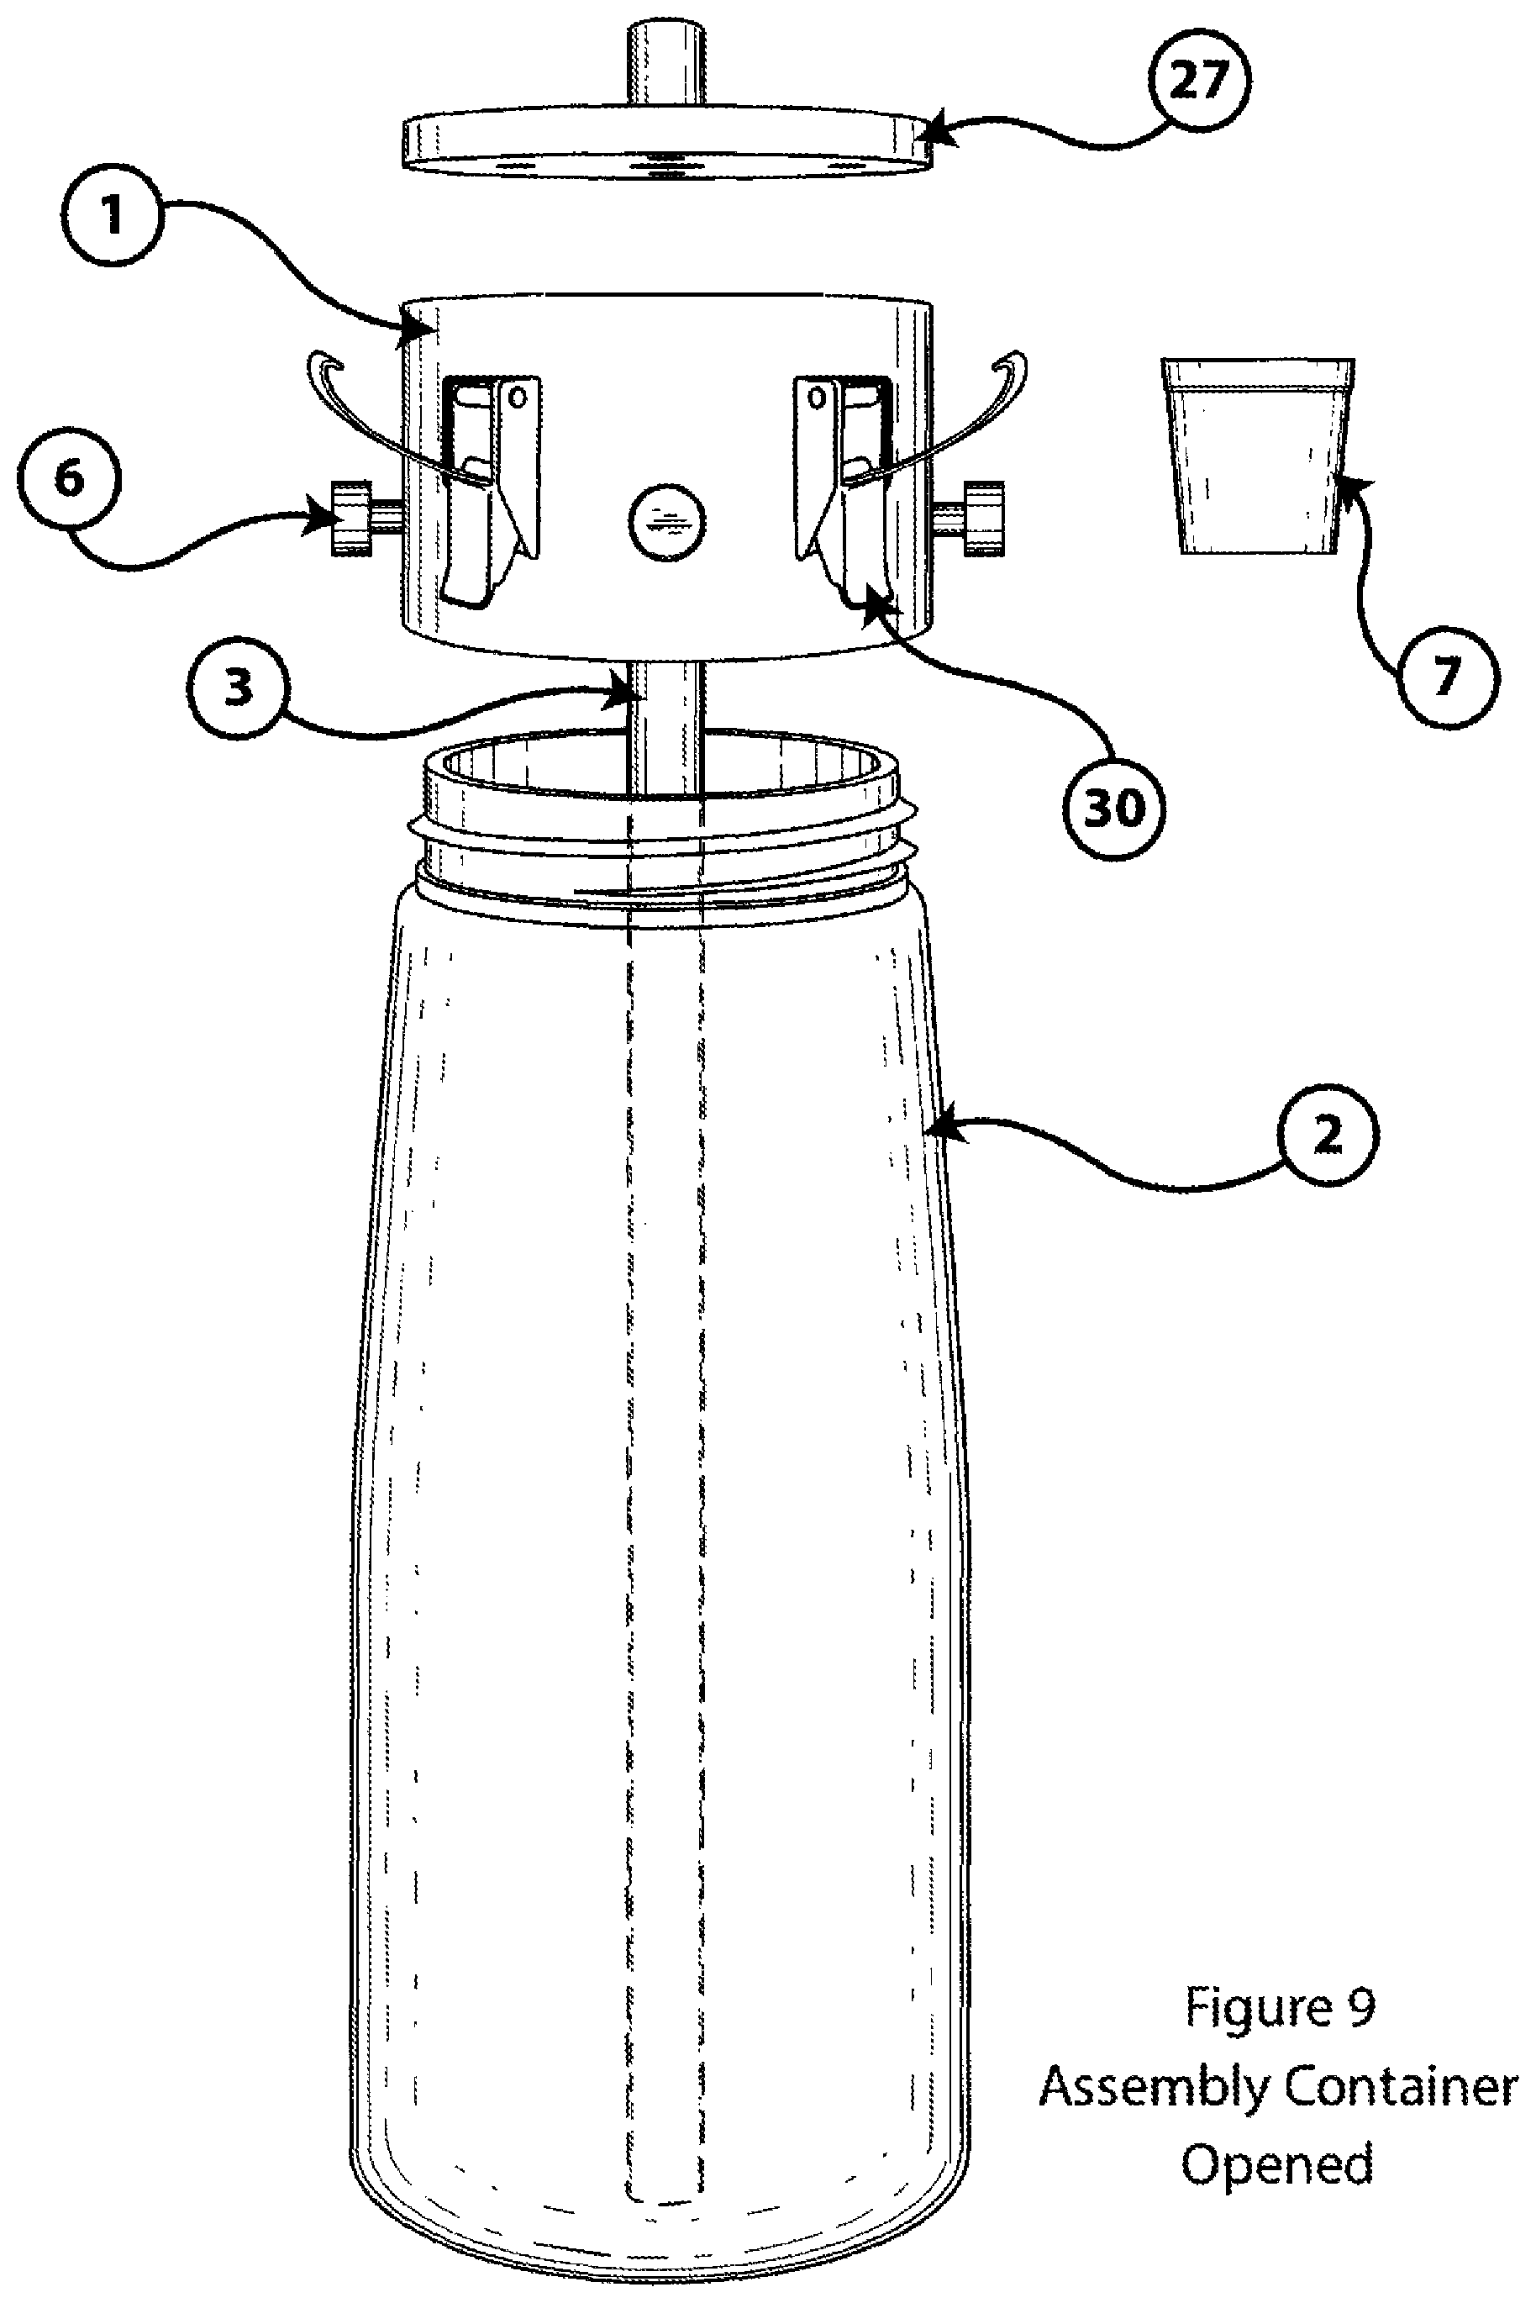
Plaintiff’s Patent Claim
Defendant’s Product
Infringement
vs
Invalidate
Patent Claims:
A beverage container comprising:
a bottom surface and a neck and a wall structure extending therebetween to form a reservoir to hold a reservoir liquid; and
a beverage container lid assembly removably connected to the neck, the beverage container lid assembly comprising….so on.

Slide 4
Blame :
"Shifting the focus to the opponent's alleged wrongdoing"
Bullet points:
- Challenging patent validity
- Alleging inequitable conduct
- Claiming unenforceability
- Defending against infringement claims

Slide 5
Claim :
"Asserting one's own patent rights"
Bullet points:
- Enforcing patent infringement claims
- Seeking damages or royalties
- Defending against invalidity claims
- Asserting patent dominance

Slide 6
Blame vs Claim Strategies :
- Blame: Invalidity, unenforceability, inequitable conduct
- Claim: Infringement, damages, royalties, patent dominance

Slide 7
Case Studies:
Real-life patent litigation cases where Blame and Claim strategies were used
Google's Defensive Patent Strategy
Apple v. Samsung (2012)

Slide 8
Google's Defensive Patent Strategy :
Example: Google's Defensive Patent Strategy :
Context : Google acquired Motorola Mobility in 2011 for its patent portfolio.
Strategy : Used patents to defend against litigation threats from competitors like Apple and Microsoft.
Outcome : Strengthened Google's position in the mobile device market and protected its Android ecosystem.

Slide 9
Apple v. Samsung (2012)
Apple sued Samsung for infringing on several patents related to smartphone design and user interface.
Samsung counterclaimed that Apple's patents were invalid and that Apple had infringed on Samsung's patents.

Slide 10
Blame Strategy (Samsung):
Challenged the validity of Apple's design patents, claiming they were obvious and didn't meet the requirements for design patent protection.
Alleged that Apple had engaged in inequitable conduct by withholding relevant prior art from the Patent Office.
- Claimed that Apple's utility patents were invalid due to prior art and lack of enablement.

Slide 11
Claim Strategy (Apple):
Asserted that Samsung had willfully infringed on Apple's patents, seeking damages and an injunction.
Claimed that Samsung's smartphones and tablets infringed on Apple's design patents and utility patents.
- Sought to protect its patent rights and dominant market position.

Slide 12
Outcome:
- The court ruled that Samsung had infringed on some of Apple's patents, but not all.
- The court also ruled that some of Apple's patents were invalid due to prior art.
- Samsung was ordered to pay damages to Apple, but the amount was significantly less than what Apple had sought.
In this case, both parties employed Blame and Claim strategies:
- Samsung used the Blame strategy to challenge Apple's patent validity and alleged inequitable conduct.
- Apple used the Claim strategy to assert its patent rights and seek damages.

Slide 13
Conclusion:
Blame Strategy :
Defensive Use of Patents & Pooling for Protection
Claim Strategy:
Offensive Strategy & Monopoly on Innovation

Slide 14
Pooling for Protection :
Sometimes, companies participate in patent pools where they contribute patents to a collective pool.
This pooling strategy allows members to access each other's technologies without fear of litigation, creating a collaborative rather than combative environment.
Example: MPEG LA - MPEG-2 Patent Pool
The MPEG-2 standard, used widely for digital television and DVDs, is covered by numerous patents held by different companies. To avoid complex and costly litigation over patent infringement, many of these companies participate in a patent pool managed by MPEG LA (a licensing agency). Companies like Sony, Panasonic, and Toshiba contribute their MPEG-2 patents to this pool. | a single license This simplifies the licensing process and reduces the risk of litigation because licensees are protected from patent infringement claims by pool members. It fosters a collaborative environment where companies can focus on developing and implementing technology without constant legal threats.

Slide 15
Claim Strategy:
Definition : Offensive use of patents to assert rights, exclude competitors, and monetize intellectual property.
Purpose : Involves actively licensing patents, negotiating royalties, or litigating to enforce exclusivity.
Example: Apple vs. Samsung Patent Litigation :
- Context : Apple sued Samsung for patent infringement in the smartphone industry.
- Strategy : Asserted patents aggressively to protect market share and seek compensation for alleged infringement.
- Outcome : Led to significant legal battles and settlements, impacting market dynamics and competitive strategies.

Slide 16
What is achieved by claiming strategies:
Offensive Strategy :
Claiming patents aggressively involves using them to assert rights and exclude others from using or implementing the patented technology. This can be done through licensing agreements (to collect royalties), negotiations, or litigation against competitors perceived to be infringing on the patent.
Monopoly on Innovation :
By claiming patents aggressively, companies aim to establish a monopoly on a particular technology or innovation. This not only provides financial benefits through royalties but also strategic advantages in the market by controlling access to critical advancements.

Slide 17
Advantages and Challenges:
- Blame Strategy :
- Advantages : Mitigates litigation risks, enhances defensive capabilities, and fosters industry collaboration (e.g., patent pools).
- Challenges : May limit offensive capabilities and potential revenue from patent monetization.
- Claim Strategy :
- Advantages : Secures market exclusivity, generates revenue through licensing, and establishes competitive advantage.
- Challenges : Higher litigation costs, potential for antitrust scrutiny, and ethical considerations of patent assertion.

Slide 18
Discussion:
- Questions to Consider :
- How could companies balance defensive and offensive patent strategies to achieve long-term competitive advantage?
- What should be the implications of patent assertion on innovation and market competition?

Slide 19
Thank you ☺

